Slide 1
project: Northwind Sales Analysis and forecasting
A Data Science Capstone Project
by Precious James
Tools used : Power BI/SQL/FORECASTING MODELS
Date: 27/06/2025

Slide 2
INTRODUCTION
This project analyzes sales, customers, and products from the Northwind trading database.
The Northwind dataset is a sample database that simulates the operations of a retail and wholesale trading company
•It includes insights into customer behavior, supplier efficiency, product performance, and forecasting future sales.
Objectives:
•Understand the data
•Derive insights
•Visualize trends
•Forecast sales

Slide 3
Database Structure
• Key tables Used:
Customers – Stores customer details like name, country,
Orders – Contains all sales transactions and order dates
Order Details Contains product, quantity, price, discount
Products – Information about each item sold
Suppliers – Companies that supply the products
Categories – Groups products into categories (e.g., beverages,)

Slide 4
Data Loading & Overview
Loaded the Northwind SQLite database into Power BI
Imported 7 key tables: Orders, Order_Details, Products, Customers, Suppliers, Categories, Employees

Slide 5
Schema Exploration
Examined table relationships in Model View
Identified primary/foreign key connections:
Orders → Order_Details
Products ↔ Order_Details
Orders ↔ Customers, Employees, Shippers
Ensured correct data types (e.g., dates, integers, strings)

Slide 6
Data Cleaning
Checked for null or missing values
Removed
Incomplete order rows
Missing customer IDs
Converted OrderDate to datetime format
Created new calculated column:
Sales = UnitPrice × Quantity × (1 - Discount)

Slide 7
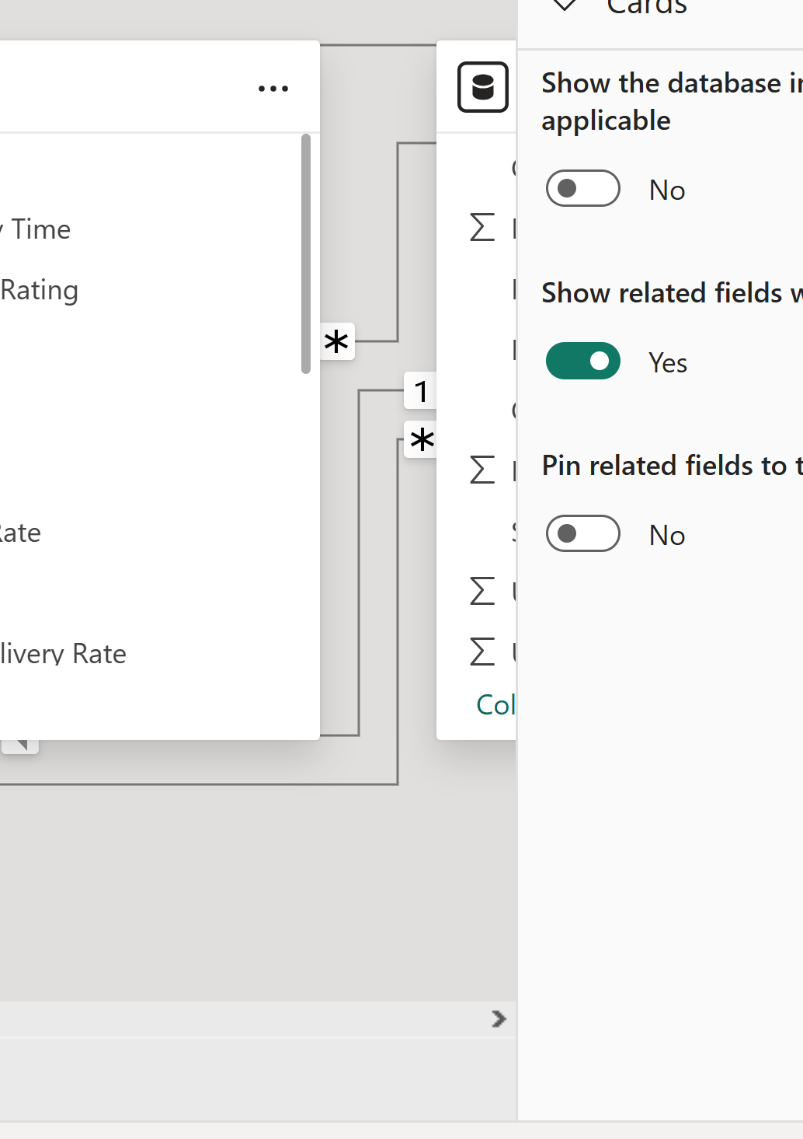
Cleaned Data
Data is clean and ready for analysis
Key tables connected by clear relationships, sales metric calculated, and datetime formats.

Slide 8
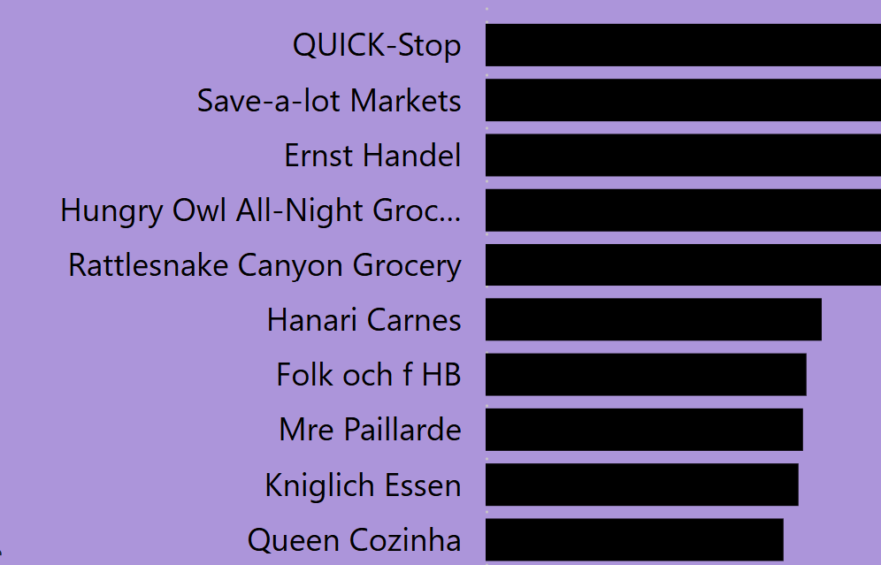
Use Case 1 – 10 Top Customers by Sales
Measure/Query Description:
To calculate total sales per customer, we multiply quantity by unit price and adjust for any discounts.
Dax measure created is :
Total Sales = SUMX('Order Details','Order Details'[UnitPrice] * 'Order Details'[Quantity] * (1 - 'Order Details'[Discount]
•Power BI Visuals:
QUICK_STOP buys the most

Slide 9
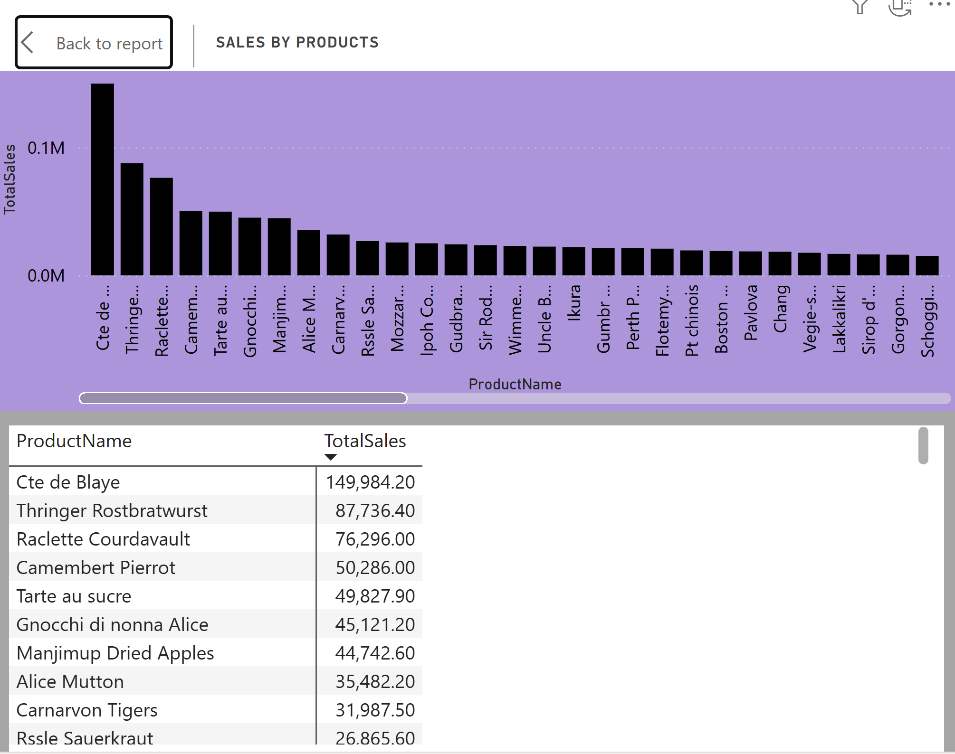
Product Performance
Calculated sales as: UnitPrice × Quantity × (1 - Discount)
Grouped sales and quantity by product
Visualized top 10 products by total sales and quantity sold
Used tree maps and bar charts for comparisons
Insight:
Some products had high sales but low profit margins due to discounts

Slide 10
ORDER TRENDS OVER TIME
Analyzed order volume and total sales over time (monthly)
Converted OrderDate to proper datetime format for time series analysis
Created line charts to visualize trends over time
Identified seasonal peaks and sales dips
Insight:
Sales increased significantly during December

Slide 11
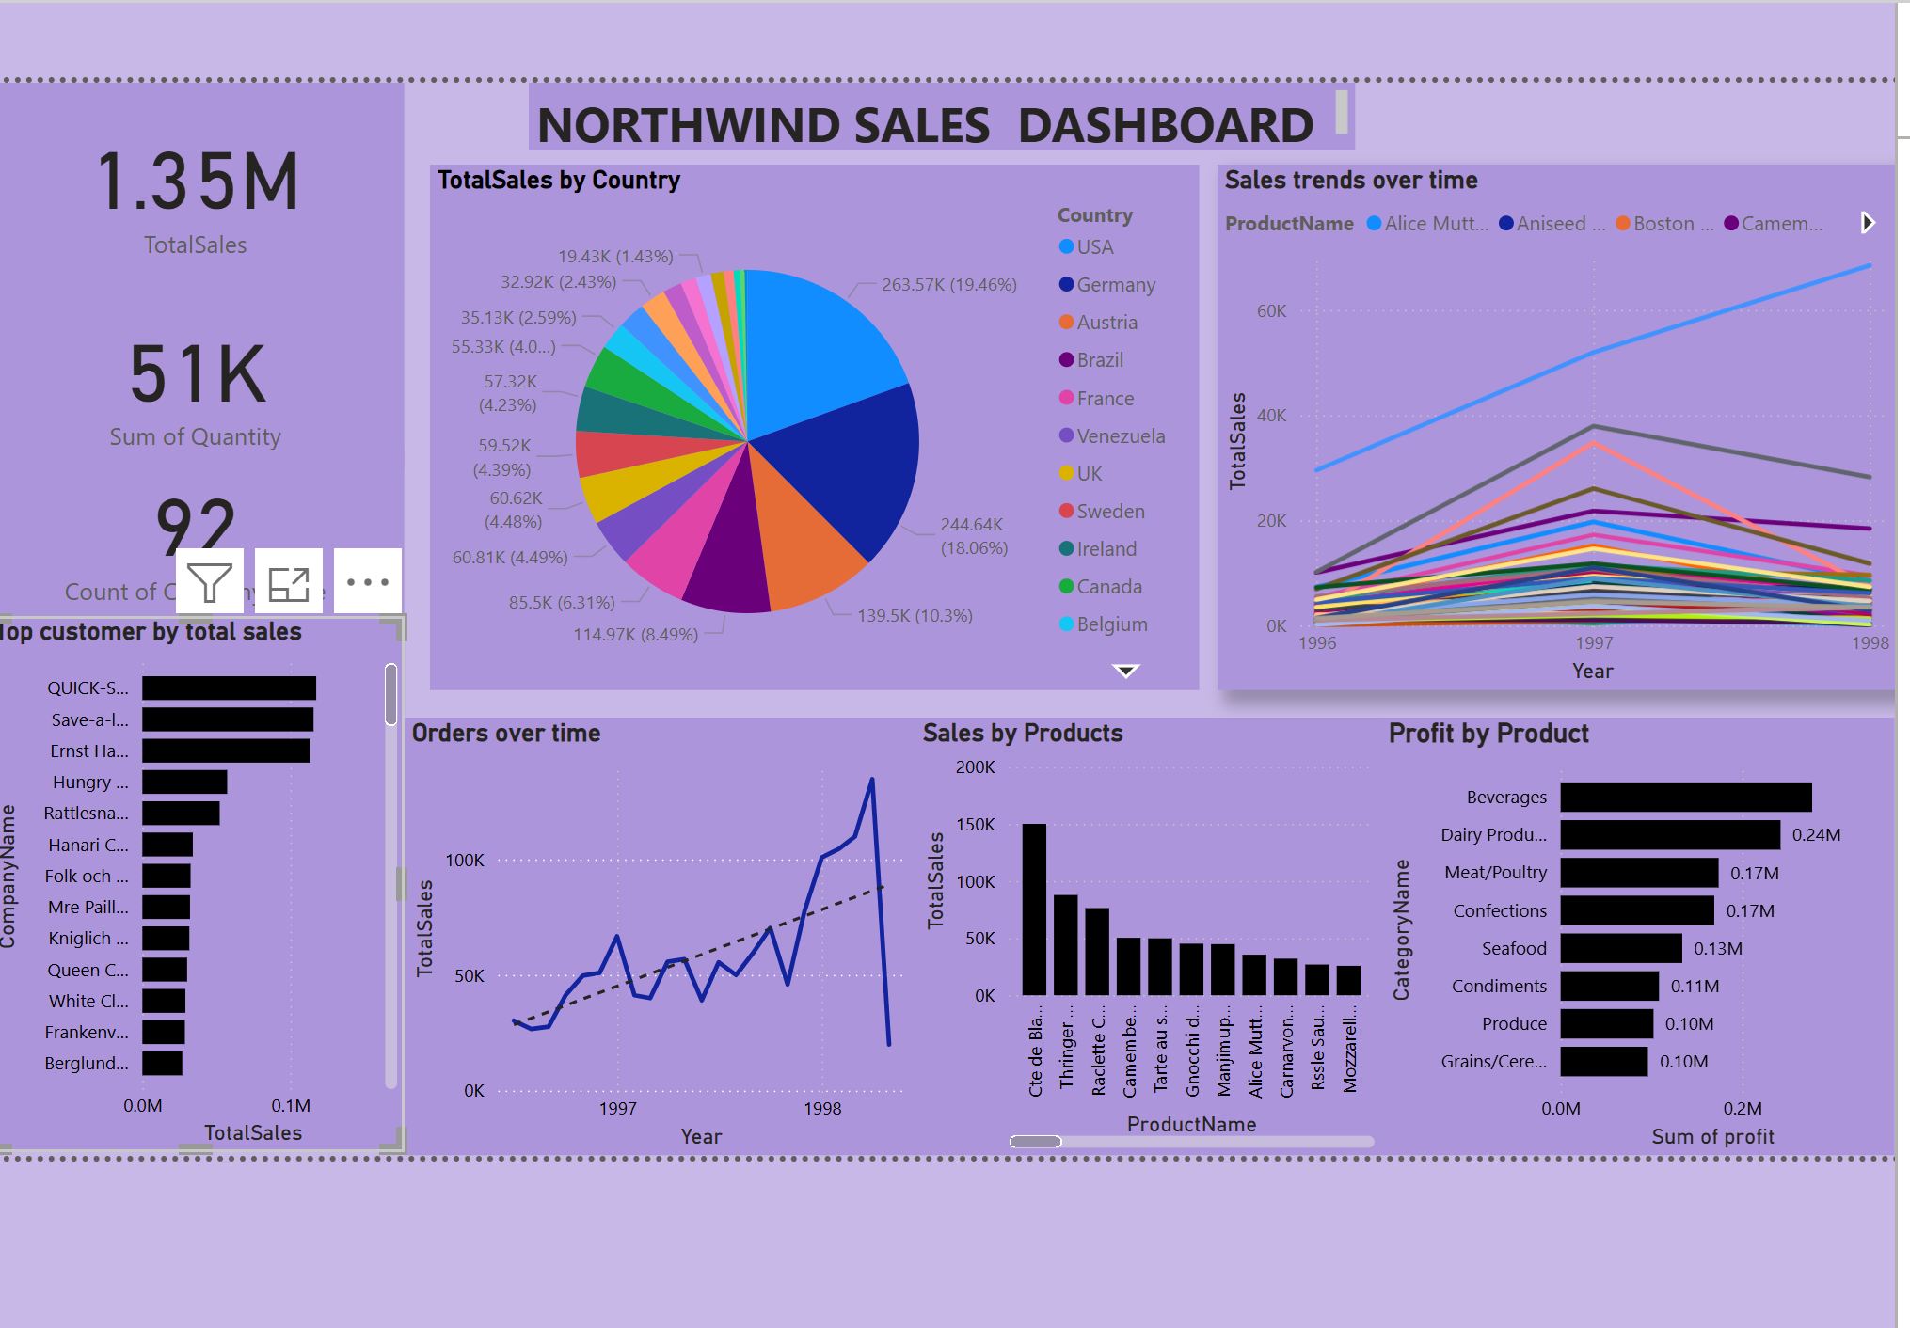
DASHBOARD SUMMARY(POWERBI)
Displays key metrics: Total Sales, Orders, Top Products
Visuals used: Bar chart, Line chart, cards
Filters available:
Time Period: Monthly/Yearly
Region : Customer Country
Product Category

Slide 12
SALES FORECASTING
FORECASTING OBJECTIVES
The goal is to apply time series analysis on historical order data to forecast future sales trends.
This allows the business to identify seasonal patterns, detect growth opportunities, and make better data-driven decisions for future planning.

Slide 13
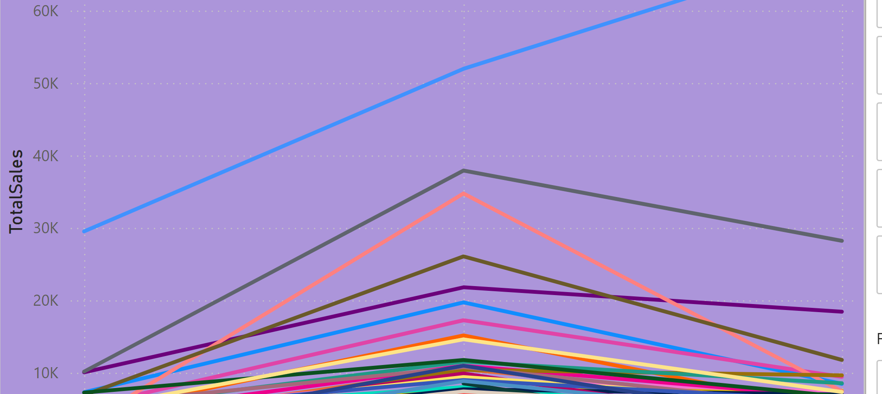
WHY FORECASTING
The objective of my forecasting was to predict monthly sales trends using past order data. This helps the business anticipate demand, especially during seasonal peaks, and optimize inventory planning
.I applied three forecasting techniques: Moving Average for smoothing short-term fluctuations, Exponential Smoothing for trend capture, and ARIMA for a more robust time-series prediction.This combination allowed me to assess which method performed best for the dataset and to generate reliable sales forecasts for future planning.

Slide 14
DATA PREPARATION FOR FORECASTING
Before applying any of the forecasting models I used, I needed to prepare the data. First, I joined the Orders, Order Details, and Products tables using OrderID and ProductID. Then I grouped the data by month and calculated total monthly revenue. After that, I aggregated all monthly sales to form a proper time series.
Finally, I handled missing months like those with zero by using zero-fill and interpolation to create a continuous time-based dataset for forecasting.

Slide 15
FORECASTING MODELS
Models applied are
1. Moving Average
2. ARIMA
3. Exponential Smoothing

Slide 16
MOVING AVERAGE
A Moving Average (MA) model is a time series forecasting technique used to smooth out short-term fluctuations and highlight longer-term trends or cycles in data.
Moving Average smooths out short term fluctuations

Slide 17
Types of Moving Averages:
1.Simple Moving Average (SMA)
2. Exponential Moving Average (EMA)

Slide 18
Forecast Model Evaluation
Evaluated models using MAE (Mean Absolute Error) and RMSE (Root Mean Squared Error)
Lower values indicate better forecast accuracy
Models compared: Moving Average, ARIMA,and Exponential Smoothing

Slide 19
EVALUATION RESULT MAE AND RMSE
Model | MAE | RMSE
Moving Average | 2.58 | 2.80
ARIMA (1,1,1) | 1.56 | 2.80
Exponential Smoothing | 1.79 | 1.98
The most accurate model with Mean Absolute Error(MAE) is ARIMA (Autoregressive Integrated Moving Average with 1.5
The most accurate model with Root Mean Error (RSME) (ETS) Exponential Smoothing With 1.98

Slide 20
Business Recommendation
1
2
3
Adjust pricing or bundle with(Beverages) high-margin items
Limit discounting for underperformers like condiments products, Grains/cereals as they are the lowest products
Optimize logistics before expected peak periods for the high performing products (Beverages)

Slide 21
CONCLUSION
•Northwind’s top revenue drivers are predictable and seasonal
•Insights show opportunity in Beverages and key clients
•Forecasting supports better decision-making
•Tools used: Power BI, SQL, Python

Slide 22
GitHub & Deliverables
•Contains:
•Power BI (.pbix)
•Forecasting notebook
•README with full project steps
•Also submitted: PowerPoint & Documentation

Slide 23
THANK YOU
Questions
Contact (preciousjames468@gmail.com)

